Slide 1

SMART ATTENDANCE
13/8/2023(SUN)
Nu Nu Hlaing

Slide 2
Our Team
Tr. Cynthia
Supervisor of Computer Vision
Batch - 7
Nu Nu Hlaing
Candidate of Computer Vision
Batch - 7

Slide 3
Project Timeline
Within 2 weeks (31/07/23 ~ 12/08/23)
Planning (2days)
Data Collection and Preparation (3days)
Evaluation and Validation (6days)
User Interface Development (1day)
Prepare Presentation Slide (1day)

Slide 4
Introduction
SA is a clever way to manage attendance using computers.
Instead of saying names or using paper, it takes pictures of people with webcams without having to ask.
It uses webcams to quickly recognize faces in real-time, changing the way attendance is recorded by using Harr Cascade Classifier.
This makes attendance tracking faster and more accurate.
It's like having a smart helper that takes care of attendance without any manual effort.

Slide 5
Motivation & Objectives
Motivated by the need
Objectives
To modernize traditional attendance processes
To revolve real-time monitoring
To minimized human error, data entry mistakes
To maintain the security & privacy of data
To save time, such as rollcall-taking time
To enhance user convenience and innovation
To create a better learning environment

Slide 6
Data Collection
We used Celebrity Faces as Data
Downloaded from Kaggle Datasets
Total Data – 1,170
Train Data – 80%, Test Data – 20%

Slide 7
SA’s Processes
1
2
3
4
5
Train
& Save
Model
Load the
trained
model
Identify staff using
webcam and image
Save attendance
in a csv file
Data Preprocessing
&
Algorithm
Experiments
Extract Face images using the Harr Cascade Classifier technique
The model is trained using input images employing CNN algorithms.
The trained model is loaded
Algorithms
is used to identify the staff
With predicted staff’s name, date and current time are saved in a csv file

Slide 8
Data Preprocessing
All the images are normalized to (400, 400) as the image data had variety of sizes
The images are rescaled to 1./255
The images are performed a specific image processing operation such as Random Flipping, Filter, Brightness and Contrast Adjustment
Face detect with Harr Cascade Classifier and save it

Slide 9
Acquiring Knowledge of Algorithms
This four algorithms for prediction
Artificial Neural Network (ANN)
Convolutional Neural Network(CNN)
Keras Sequential Model
Haar Cascade Classifier

Slide 10
What is ANN?
ANN, also known as a fully connected neural network or a multi-layer perceptron, is a basic and versatile type of neural network.
ANN pass information in one direction, through various input nodes, until it makes it to the output node.
The network may or may not have hidden node layers, making their functioning more interpretable.

Slide 11
What is CNN?
A convolutional neural network (CNN) is a network architecture for deep learning that learns directly from data.
CNNs are mainly credited for their role in image and video recognition, recommendation systems, and image analysis and classification.
Three of the most common layers are convolution, activation or ReLU, and pooling.
Convolution layer focus on interpreting simple features in an image such as its edges and colors.
Rectified linear unit (ReLU) layer is abled to recognize complex features such as object shapes.
Pooling layer is abled to identify the target object.

Slide 12
What is Keras Sequential Model?
Keras is an open-source deep learning library that provides a high-level interface for building and training neural networks.
The Sequential model in Keras is a type of model that is commonly used to create simple neural networks by stacking layers on top of each other in a linear manner.
It is easy to use and suitable for building feedforward neural networks where the data flows sequentially from the input layer to the output layer.
Each layer in the model has weights that are learned during training to transform the input data into more meaningful representations.

Slide 13
What is Haar Cascade Classifier?
The Haar cascade method is used to detect faces in each frame of the webcam feed.
The region of image containing the face is resized to 400x400 and is passed as input to the CNN.
The network outputs a list of softmax scores for the seven classes of emotions.
The emotion with maximum score is displayed on the screen.

Slide 14
Result of Experiments
Algorithms | Settings | Confusion Matrix | Accuracy | Precision | Recall | F1 Score
ANN | TargetSize = 400,400 Epochs = 10 BatchSize = 5 Data = 1,170 |  | 93.58% | 94.62% | 92.06% | 92.57%
CNN | TargetSize = 400,400 Epochs = 10 BatchSize = 5 Data = 1,170 |  | 96.58% | 97.35% | 95.97% | 96.52%
Keras Sequential Model | TargetSize = 400,400 Epochs = 10 BatchSize = 5 Data = 1,170 |  | 39.74% | 13.24% | 33.33% | 18.96%
78 | 0 | 0
0 | 93 | 0
15 | 0 | 48
76 | 2 | 0
0 | 93 | 0
0 | 6 | 57
0 | 78 | 0
0 | 93 | 0
0 | 63 | 0
The outcomes demonstrate that the CNN algorithm is highly effective for both training and testing images.

Slide 15
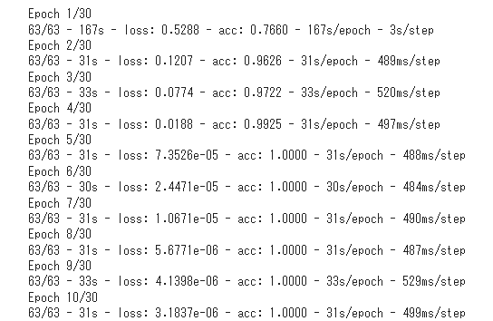
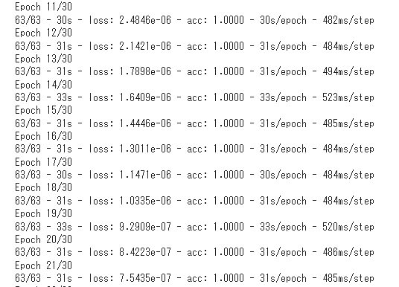
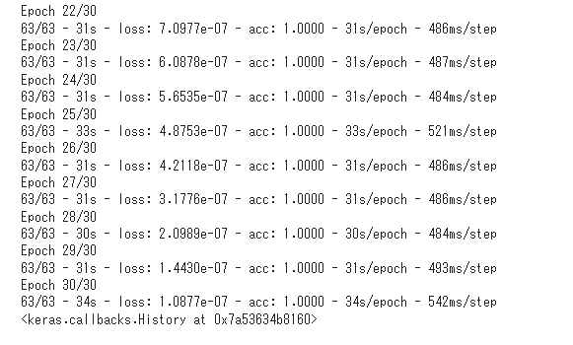
Modeling using CNN
Target Size: 50, 100
Epochs: 30, Batch_Size: 10
Number of Classes :
Angelina Jolie : 0
Nu Nu Hlaing : 1
Will Smith : 2
Found 936 images belonging to 3 classes.
Found 234 images belonging to 3 classes.

Slide 16
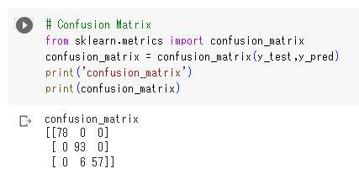
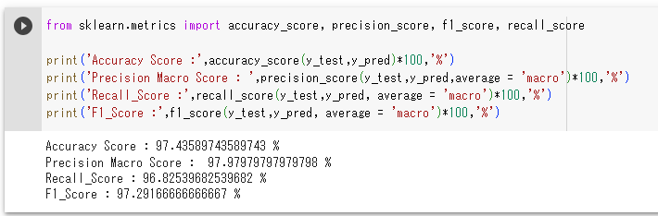
Evaluation

Slide 17
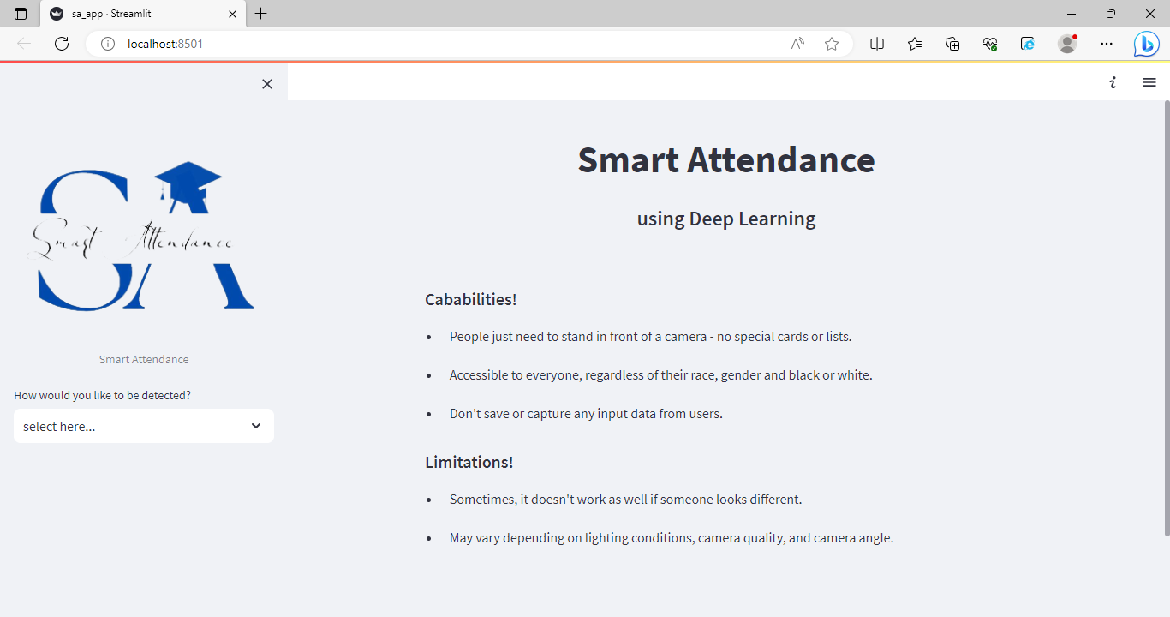
User Interface
SA develops user interface using Streamlit
Title and Description
Capabilities and Limitations
Image Upload Section
Webcam Feed
Face Prediction Results
Daily Attendance CSV File
Contact Us

Slide 18
AI Ethics
Privacy & Security
Explainability
・Don’t save any input data from users
・ Avoid deploying the system where it could be used for unethical purposes
・ Easy to use with user-centric design
・People just need to stand in front of a camera
- no special cards or lists.
Limitations
Fairness
・ Treat everyone fairly and equally without any bias based on factors like race, gender, or background
・Sometimes, it doesn't work as well if someone looks different.
・ May vary depending on lighting conditions, camera quality, and camera angle

Slide 19
Future Work
Due to lack of time and resources we conclude at an intermediate state of this work.
Whoever wishes to proceed further can take these points!
Model optimization : To extend the model to be more culturally sensitive and adaptable. Train model with unique ID rather than Name. Dataset expansion : To expand and diversify the dataset to ensure it represents a wide range of people. Data augmentation: To improve performance in challenging environments, such as varying lighting conditions, pose variations that can impact accurate face recognition
Real-time Performance :
To optimize the model for real-time processing to provide immediate updates without delay.

Slide 20
LIVE DEMO
https://github.com/NuNuHlaing/Smart-Attendance.git

Slide 21
Q & A

Slide 22
References
Face Recognition: https://github.com/juan-csv/face-recognition
Haar Cascade: https://github.com/opencv/opencv/tree/master/data/haarcascades
Dataset from Kaggle
Open Source Libraires, ChatGPT

Slide 23
THANK YOU!

